Slide 1
Augmented Reality Headset Capstone Presentation
Michael-Angelo Yadao
Nicholas Cierson
Rahul Patel
Kostas Zoitakis
Muhammad Haseb Ellahi
Faraz Yunus
Amir Shawwa

Slide 2
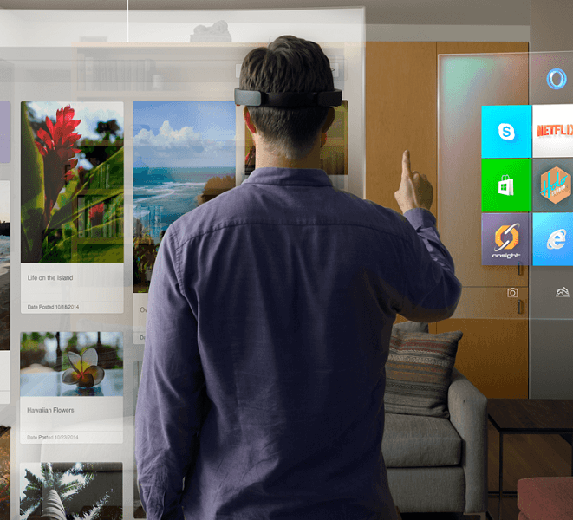
Introduction
Augmented Reality (AR) is a relatively new technology that allows the interaction of virtual objects into reality.
Unlike Virtual Reality (VR), the user is not completely submersed into another reality.
By superimposing virtual objects into the field of view, the user’s can interact with both reality and digital information with hand gestures.

Slide 3
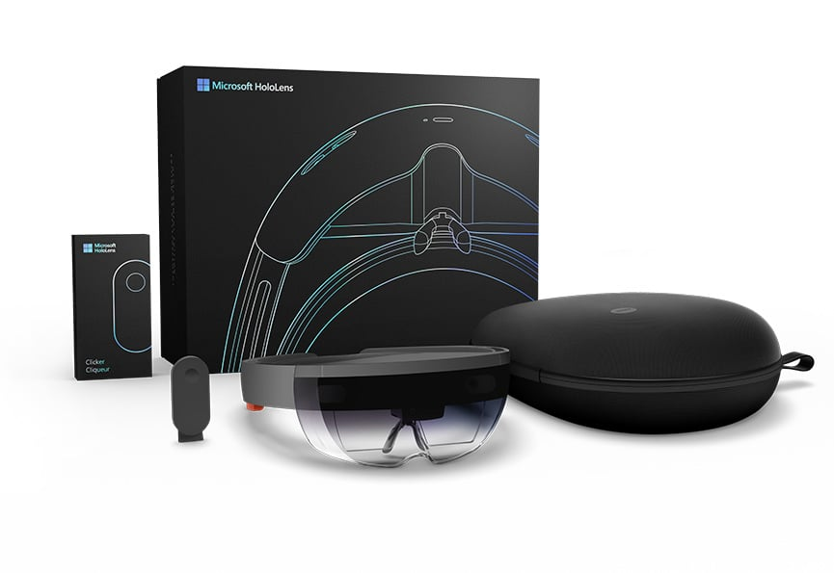
Problem Statement
Current industry leading AR products are incredibly expensive (ex: Microsoft HoloLens ~4000$ to ~6670$)
Products operate in the manufacturer’s operating system (ex: Windows 10)
Technology and hardware isn’t upgradable/interchangeable.
Several “cons” even with industry leading products such as:
Narrow field of vision (35-40 degrees)
Bulky setup
Requires very good lighting

Slide 4
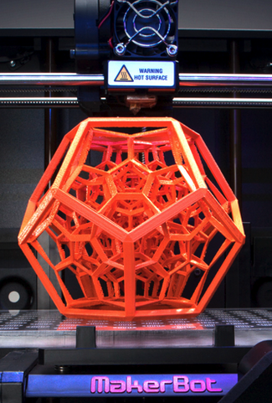
Our Objective
Build a completely open-source augmented reality headset that can be built from scratch by anyone in the world following a set of instructions.
This entails:
Manufacturing the entire headset case with a 3D printer
Using only widely available purchasable hardware (Odroid XU-4, Raspberry Pi, Intel RealSense R200, BNO 055 accelerometer, etc.)
Open source code and software that can be downloaded by any user around the world
Keeping the total cost of the headset much more affordable than standard industry AR headset (<500$)

Slide 5
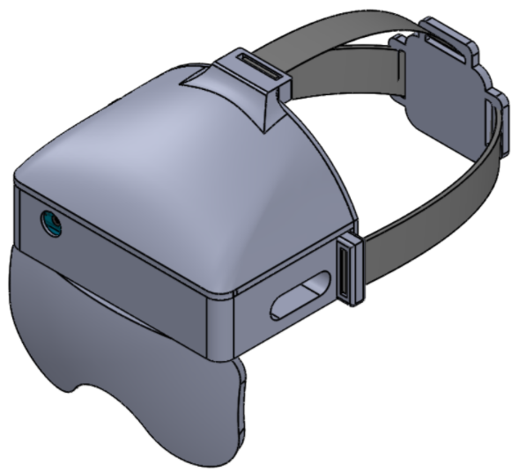
Design – 1st Iteration
Main objective: Design the headset to incorporate all components
Odroid XU4
Intel realsense r200
Adafruit BNO 055 motion sensor
HDMI screen
Design procedure:
Design headset to include the components and create cut-outs to position them, create slots for wires to go through and buckle straps .
Design top cover to protect the components and to have a buckle strap.
Design a back cover which will cover both the headset and the top cover.
Design a back piece for straps to go through.

Slide 6
Design – 2nd Iteration
Main objective: to fit all the wires of the components by increasing the overall width and length of the headset.
Modifications done:
Extending the slot for the intel realsense r200 wire to connect to the Odroid XU4.
Rotate orientation of the Odroid XU4 cut-out to pass the wires to the sides and through the slots to connect to the other components.
Relocate position of the BNO 055 motion sensor cut-out.
Increase width of top slots for wires to go through.
Top cover: increased the thickness of buckle strap.

Slide 7
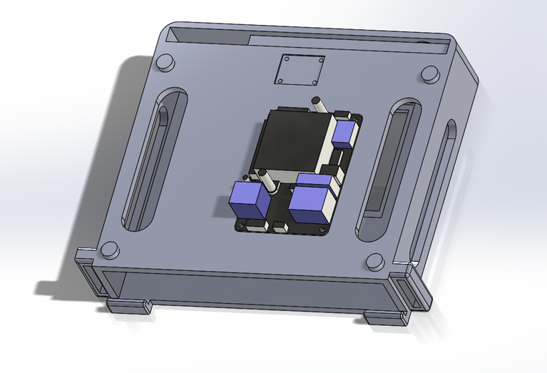
Wider slots for wires to pass through
Slot extended for the intel realsense r200 wire
Orientation of Odroid XU4 rotated for wires to be on the sides and pass through the slots

Slide 8
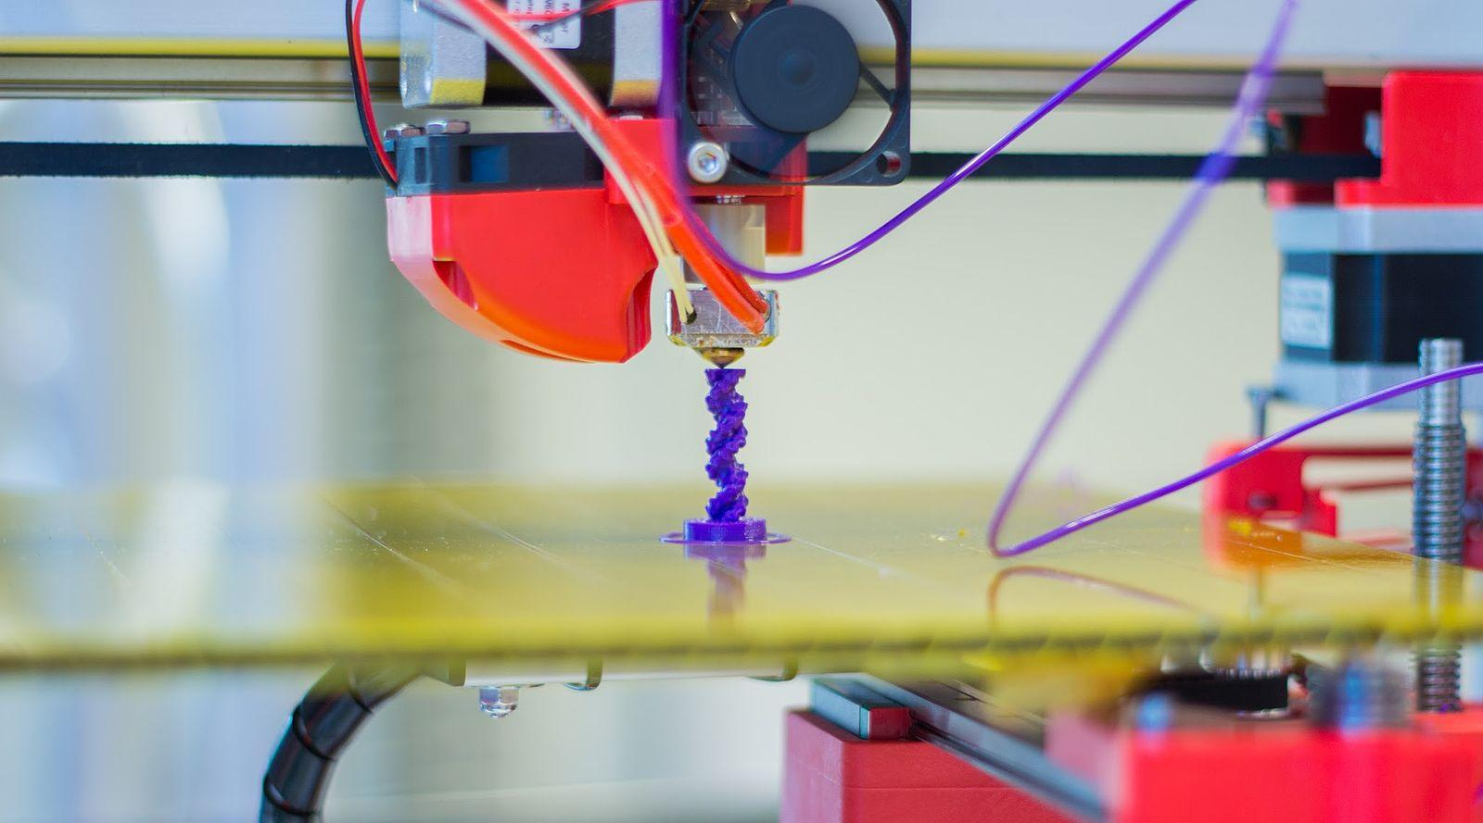
Manufacturing Issues and Long Term Objectives
3D printing
Sandbox: unreliable, fixed service hours, and lack of precision
3D Hub: reliable, unlimited service, costly but excellent precision
Long Term Objectives
•3D print the headset case with all the HW components properly fixed (including wiring configuration)
•Minimum wires (use wireless keyboard & mouse, battery)
•Fully adjustable and interchangeable headset (3 options)

Slide 9
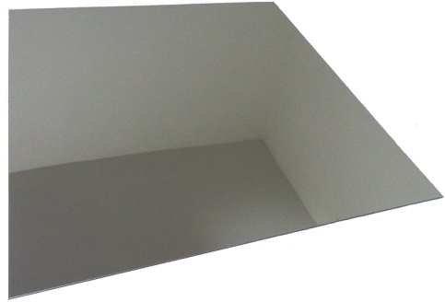
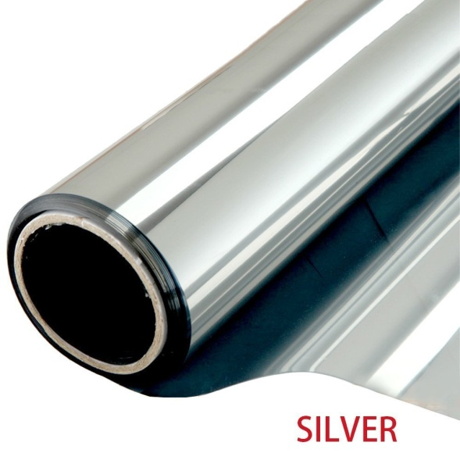
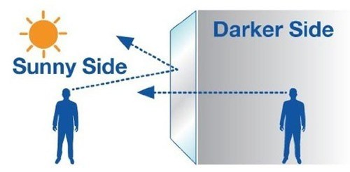
Next Development: The Display
Main Issues:
Must be able to see out from the visor
Must be able to see projections from the screen
We will need to combine the light from the outside world and the screen. First Iteration: One way mirror
(Partially reflective, partially transparent)

Slide 10
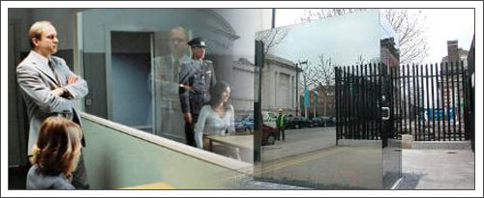
First Iteration: One Way Mirror
Can see through from the darkened side to the lighter side.
Light in the area where the headset intends to be used becomes a constraint.
Must be used in a well lit area.
Things to consider once first display is built:
Distance between the display and user`s eyes
Angle of the display
Brightness levels of the screen / environment

Slide 11
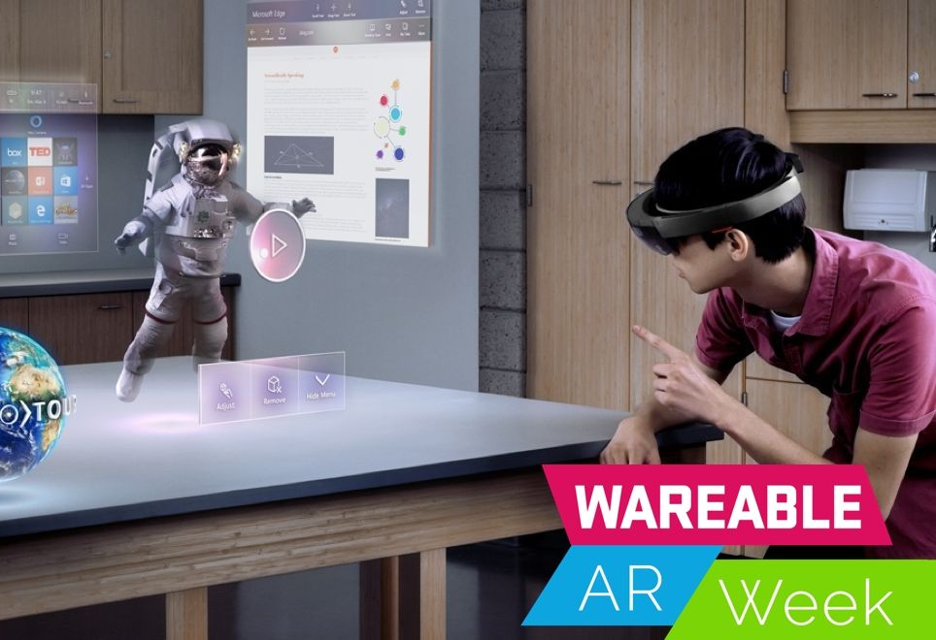
Headset Interface
ODROID XU4 Computer will control the screen.
The screen will project the image onto a lens, creating the 3D image in space.
Intel depth sensor will be used for 3D scanning.
Motion sensor integrates accelerometer, gyroscope and magnetometer.
The goal of the 3D printed design is to hold all the components together for a comfortable user experience.

Slide 12
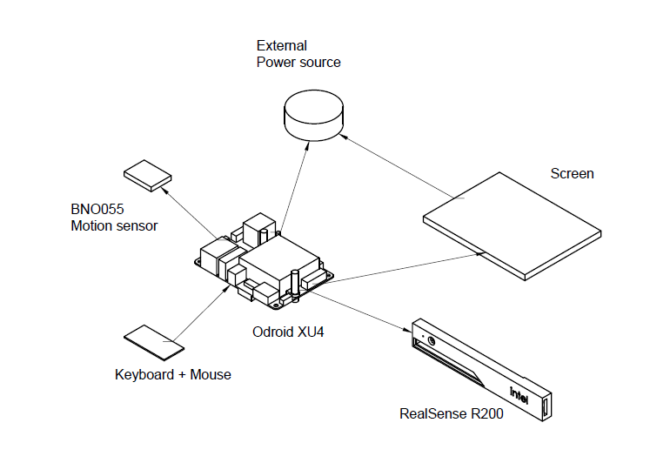

Slide 13
Augmented Reality Headset Testing
We will be performing three tests on the AR headset
Drop Test
Thermal Test
Vibration Test
In contact with Bradford and Dainius to start and planning the equipment we will need (Wind Tunnel, Thermocouple, Vibration Machine)

Slide 14
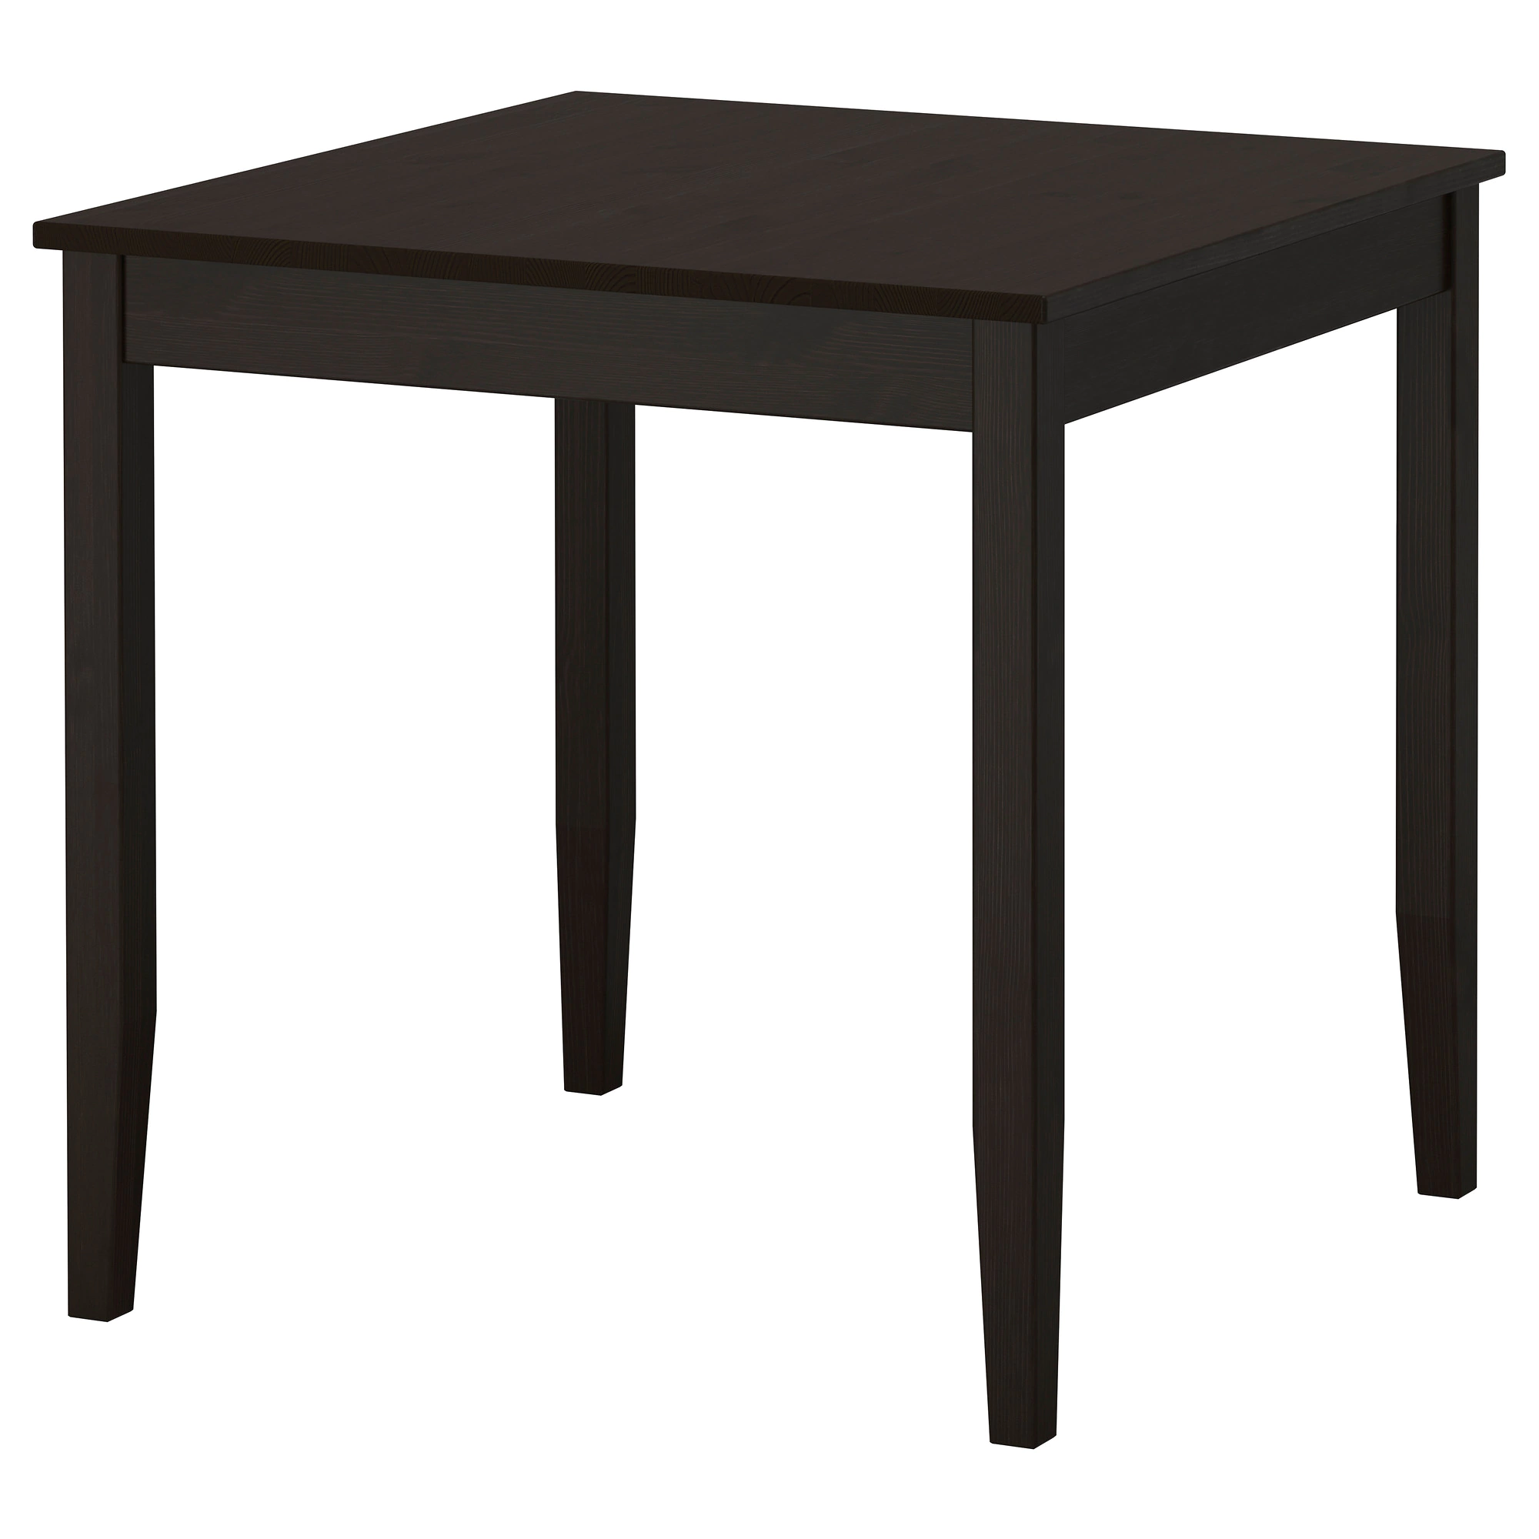
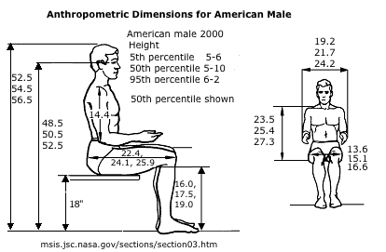
Height (Meter) | Trial 1 Failure (Y/N) | Trial 2 Failure (Y/N) | Trial 3 Failure (Y/N)
0.75
1.00
1.75

Slide 15
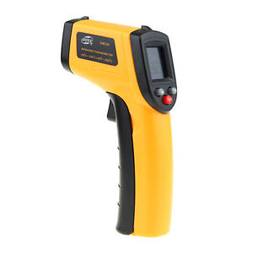
Time (Hours) | Augmented Reality Headset Temperature (°C)
0.5
1
1.5
2
Air Speed (m/s) | Time Needed to reach 2 °C to 7 °C

Slide 16
Frequency (Hz) | Observation (Failure or Not)

